Slide 1
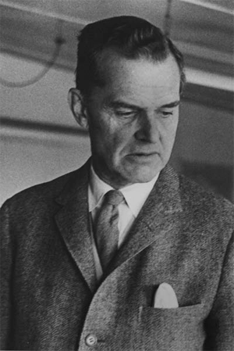
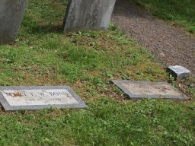
James Bond (The Ornithologist)
Born in 1900
Moved to England With His Family shortly before WWI
Came back to Phila. In early 1920s
Studied Ornithology for the Academy Of Natural Sciences
Discovered the James Bond line in Jamaica (separating North and South American Birds)
Wrote Birds Of the West Indies in 1936
This book’s author’s name was supposedly used by Ian Fleming in 1952 as he writes Casino Royale

